Slide 1
Digital Portfolio
A.Ariharan
STUDENT NAME:
REGISTER NO AND NMID:
DEPARTMENT:
COLLEGE: COLLEGE/ UNIVERSITY
241330218025210 04/asanm30224133021802521004
computer science department
Dr.R.K.S College of arts and science College Indili,Kallakurichi district. / Annamalai university

Slide 2
PROJECT TITLE
1. College web page

Slide 3


AGENDA
Problem Statement
Project Overview
End Users
Tools and Technologies
Portfolio design and Layout
Features and Functionality
Results and Screenshots
Conclusion
Github Link
3/21/2024 Annual Review

Slide 4

PROBLEM STATEMENT
Many colleges struggle to share information online in an attractive and simple way. Students and parents often find it hard to access details about courses, facilities, and staff. A static or outdated site reduces engagement and creates communication gaps.
Dr. R.K.S College of Arts and Science needs a modern website that is clear, interactive, and user-friendly. Using HTML, CSS, and JavaScript will make the site accessible, engaging, and effective in delivering information.

Slide 5

PROJECT OVERVIEW
This project focuses on developing a responsive and interactive website for Dr. R.K.S College of Arts and Science. The website will present information about the college, its departments, facilities, staff, and contact details in a structured way. By using HTML, CSS, and JavaScript, the site will ensure smooth navigation, attractive design, and interactivity for users.
The main aim is to create a platform that highlights the institution's strengths and makes information easily accessible to students, parents, and faculty. The website will improve the college's digital presence, support admissions, and provide an engaging experience that reflects the college's values and quality.

Slide 6

WHO ARE THE END USERS?
Students - to explore courses, facilities, and campus updates.
Parents/Guardians to get reliable information about admissions and services.
Faculty/Staff to showcase profiles, achievements, and academic activities.
Prospective Students to understand programs before applying.
General Public/Visitors to know more about the college.

Slide 7

TOOLS AND TECHNIQUES
The project is developed using HTML for structure, CSS for design, and JavaScript for interactivity. External stylesheets and scripts are used to keep the code clean and reusable.
Techniques like responsive design, hover effects, gradients, and dynamic navigation are applied to make the site user-friendly. Basic DOM manipulation ensures interactivity such as alerts and scroll-based effects.

Slide 8
POTFOLIO DESIGN AND LAYOUT
The portfolio website is designed with a clean and modern layout using HTML, CSS, and JavaScript. A header displays the institution's name and motto, while a navigation bar allows users to move smoothly across sections.
Each section (About, Departments, Facilities, Analysis, Employee, Contact) is styled as a card with unique colors, ensuring clarity and visual appeal. The footer provides consistent branding, and the design follows a responsive and user-friendly structure for better accessibility.
8

Slide 9
FEATURES AND FUNCTIONALITY
Features
Clean layout with colorful section cards for easy navigation.
Responsive design with hover effects and smooth scrolling.
Functionality
Interactive navigation bar that changes on scroll.
JavaScript alert to welcome users and enhance engagement.

Slide 10
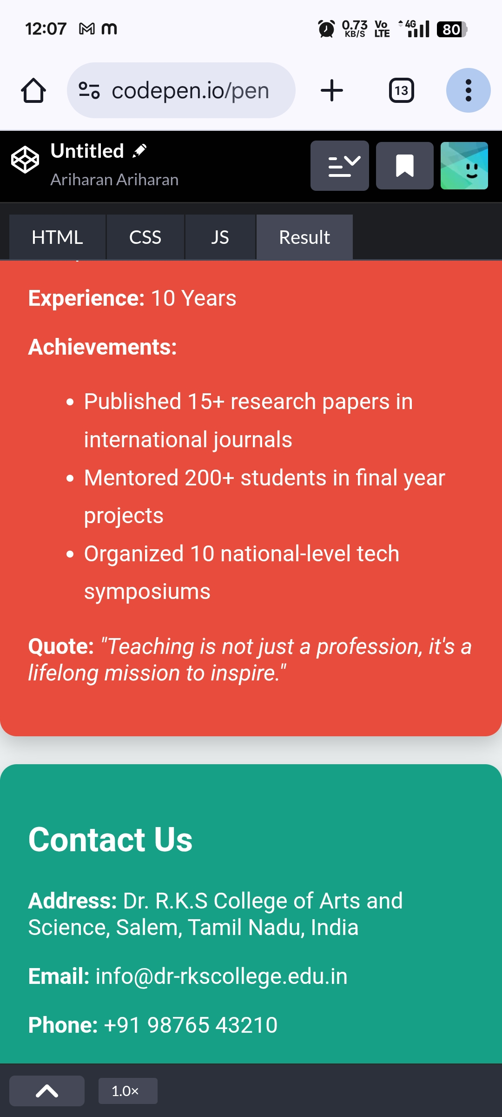
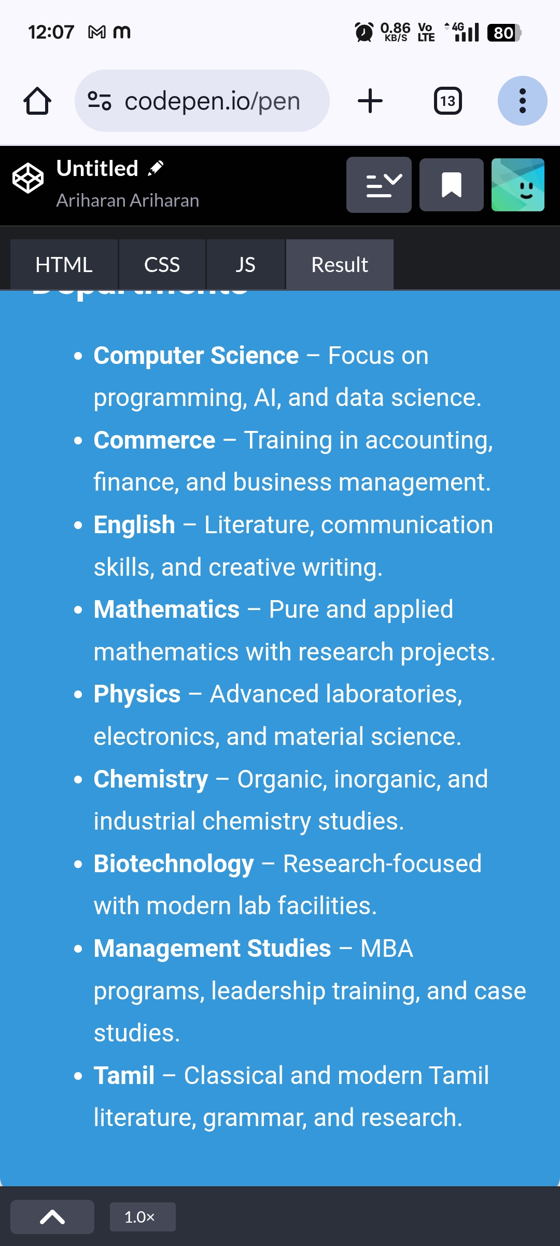

RESULTS AND SCREENSHOTS
3/21/2024 Annual Review
10

Slide 11
CONCLUSION
This project demonstrates how a college website can be effectively built using HTML, CSS, and JavaScript. It provides a structured layout, colorful design, and interactive features to enhance user experience. The site helps students, parents, and staff easily access important information. Overall, the project highlights the importance of combining design with functionality for better communication.
11

